Slide 1
Stapleford MUGA
Multi-Use Games Area
Presentation by Councillor McPhater
08/07/2020

Slide 2
The Story So Far…
The PC has approved an exploration of how S106 money could potentially be used for upgrading the existing Tennis Courts into a multi-sport venue.
A Sports Advisory Working Group was set up to help advise, evaluate, guide and participate in constructive way towards improving sports access generally in the village. Their work continues.
Three MUGA building organisations were whittled down to two in the last meeting and have now been asked to give their best and final prices.
References for each firm were sought.
Existing sporting groups in the village were contacted to see how they might best utilise a new facility.

Slide 3
The Final Two
Both firms were treated equally and given information on where they could best help their bids, without disclosing details, even names, of who they were up against.
Further “apples with apples” conversations took place to ensure both bids represented the ‘better’ solution for Stapleford.
Both firms sent electricians to the site so as to evaluate power supply issues for the lights and possibly gate.
Both firms supplied suitable references. 3 were contacted via phone/email and one had a site visit as it closely resembled the infrastructure Stapleford is contemplating.
Both firms, after further ‘encouragement’, proceeded to produce a third and final bid for this work, improving again on the financials in their second bid.

Slide 4
Reaching Out
The village Tennis Club have been contacted around how they might secure exclusive use of the facility for certain time periods via a new agreement. Response received morning of July 8th.
The SAS Strikers have been emailed regarding their interest in potentially utilising the 5-aside pitch for training etc.
A member of the WG will be liaising with Cambridge City Council about setting up Netball as a sport in the village.
Basketball remains on my “to-do” list but plenty of time will be available during the planning process to do this, if permission granted by the Parish Council to proceed to that stage.
The Sports Advisory WG met on July 1st. Minutes of that meeting will be available on the PC website shortly. This group continues to offer good advice and give up of their time for the good of sport in the village. We have one new member and one has asked to join (but not yet responded to my email .. You now who you are : )
Some members have peeled off to assist more on the children’s playground initiative but their help to date is noted and appreciated.
Cllr Fane was emailed on 17th June for indicative advice around planning permissions required.

Slide 5
Imagining The MUGA
The MUGA will be encased in a 3m high reinforced fence.
The surface will be a synthetic ‘carpet’ like material ideal for tennis, netball and football (wearing sneakers). This will go on top of a cleaned, repaired and ‘de-rooted’ existing surface with a thin porous membrane between the two. Overall drainage will be improved.
New nets, hoops and peripheral material will be purchased.
Firms were asked to produce a court layout so that villagers can see how the courts will look.
Some design tweaks have been made so let’s go through that now…

Slide 6
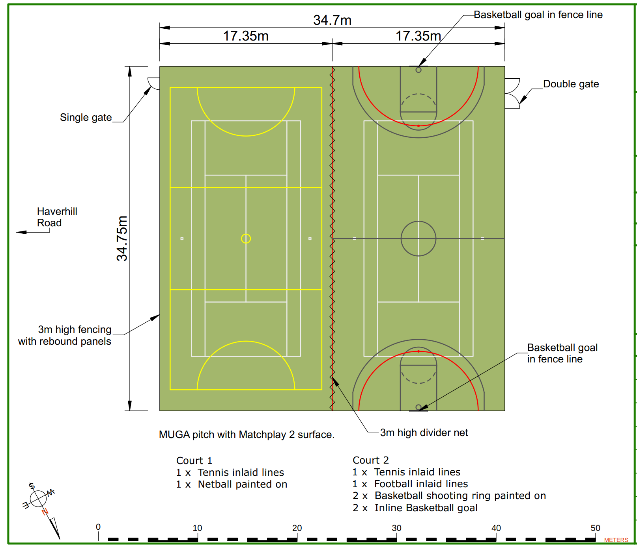
We are using the existing footprint of the tennis courts. Enlarging would be cost-prohibitive.
The single gate alone will be wide enough for wheel chair access.
The double gate allows for maintenance access.
Tennis on both courts
Netball on Court 1
Football on Court 2
Only one Basketball hoop near the double gate for now but positioned so we could add a full court if demand grows over time.
Basketball lines painted on: the others would be inlaid – physically part of the carpet.
Rebound panels at the bottom for protection.
Football Goals attached to the fence.
Tweener lights all along sides A and B
Side B is nearest Haverhill Road
Retractable Divider Net to separate two different sports
Tennis – White
Netball – Yellow
Football – Red
Basketball - Black
A
B

Slide 7
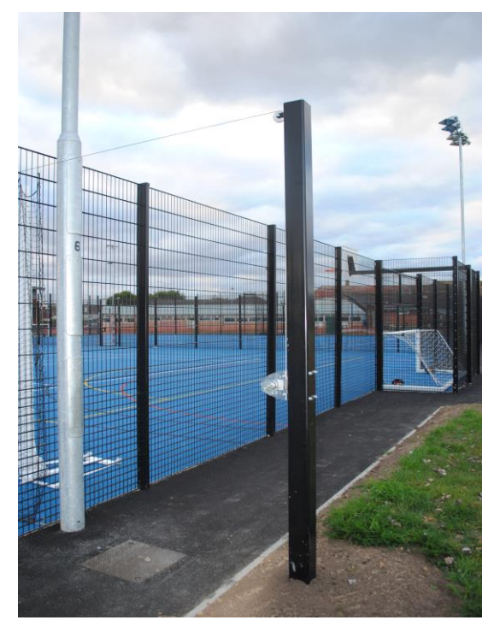
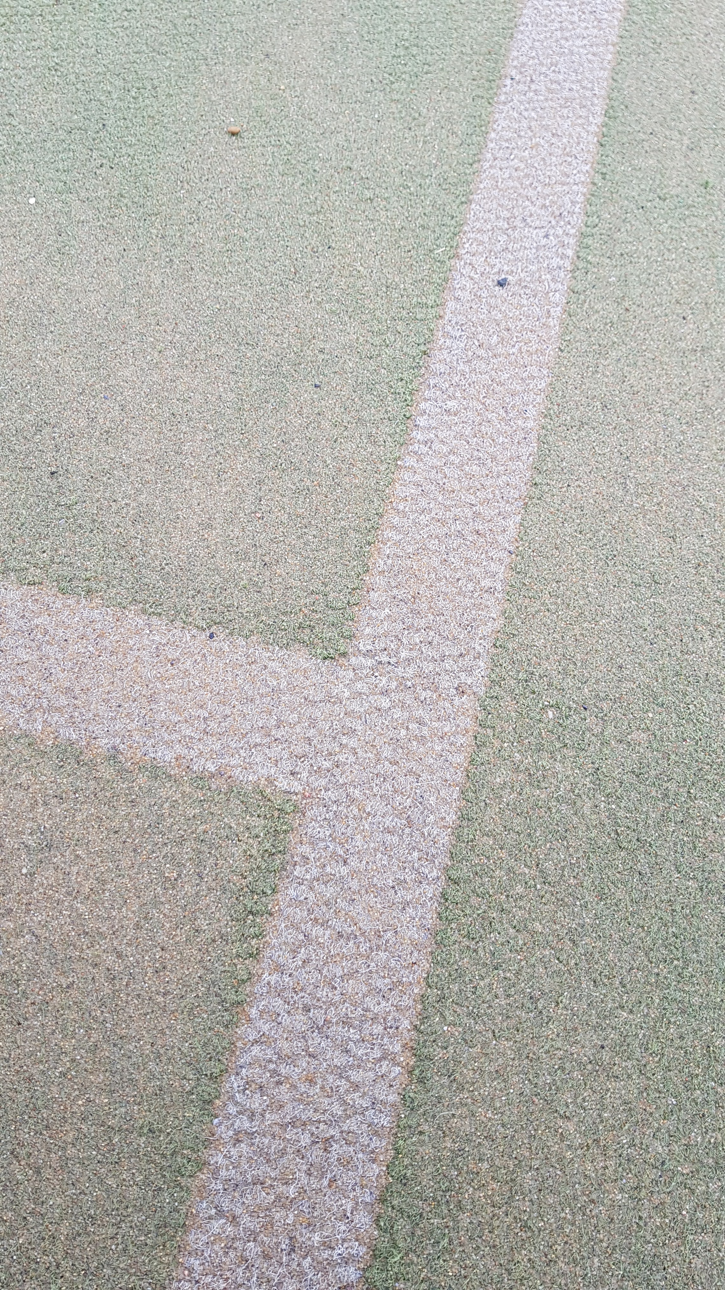
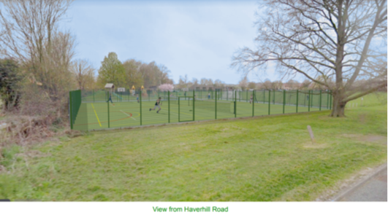
How It Would Look
Divider Net
Inlaid Lines: sand is
poured on the surface
to give it resilience

Slide 8
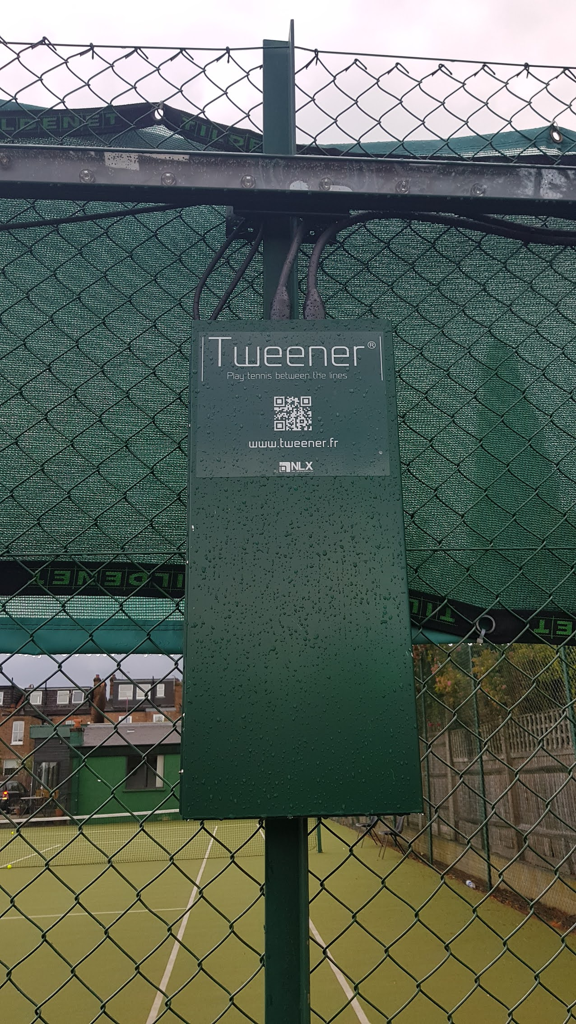
Tweener Lights
Tweener lighting is attached near to the top of the new MUGA fence and doesn’t require large posts. Overall it is a less invasive lighting solution.
Wiring will need to be secured.
Some gauze/netting attached to the new fence would considerably limit any light pollution.
We could also consider a laurel hedge at a safe distance from the fence to further reduce glow.
Feedback from users at Muswell Hill TC, London was that 2/3 players preferred Tweener to the existing pylon flood lights.
Low running cost.

Slide 9
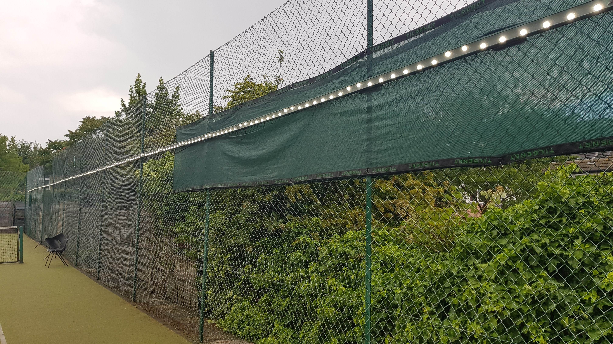
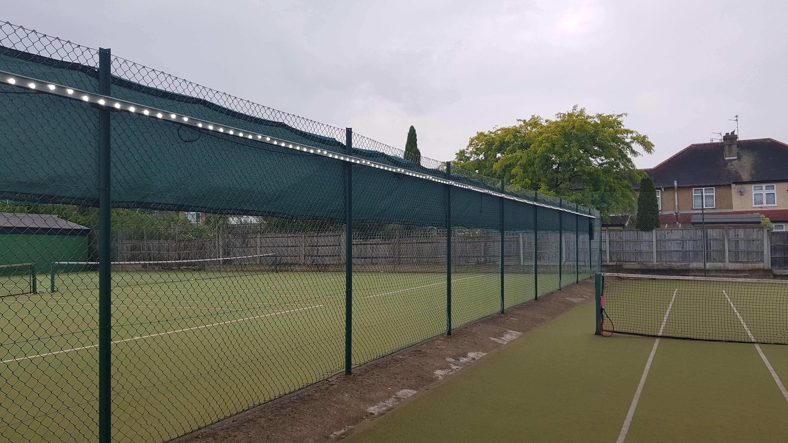
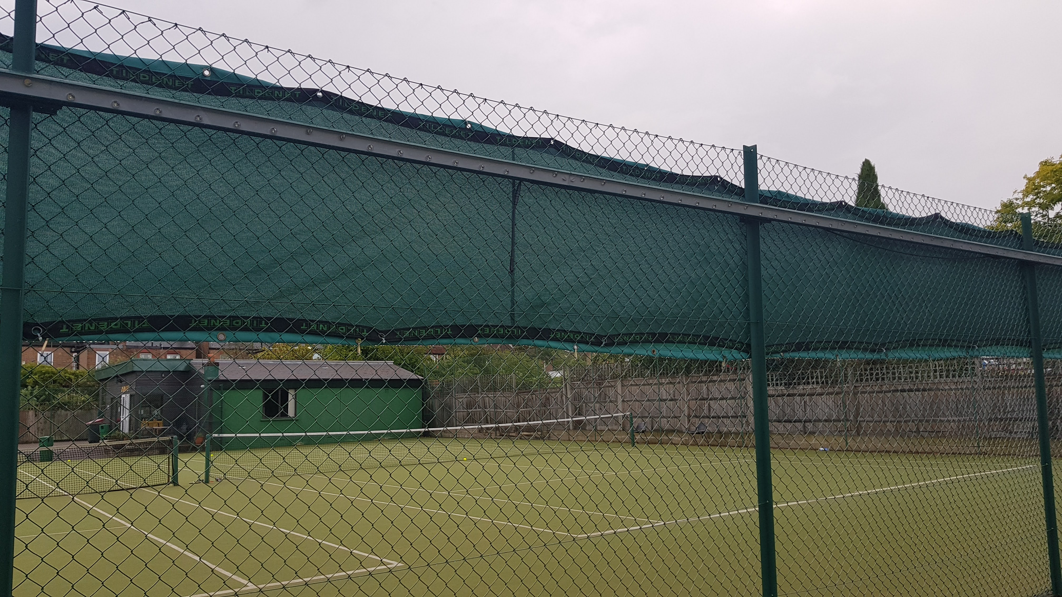
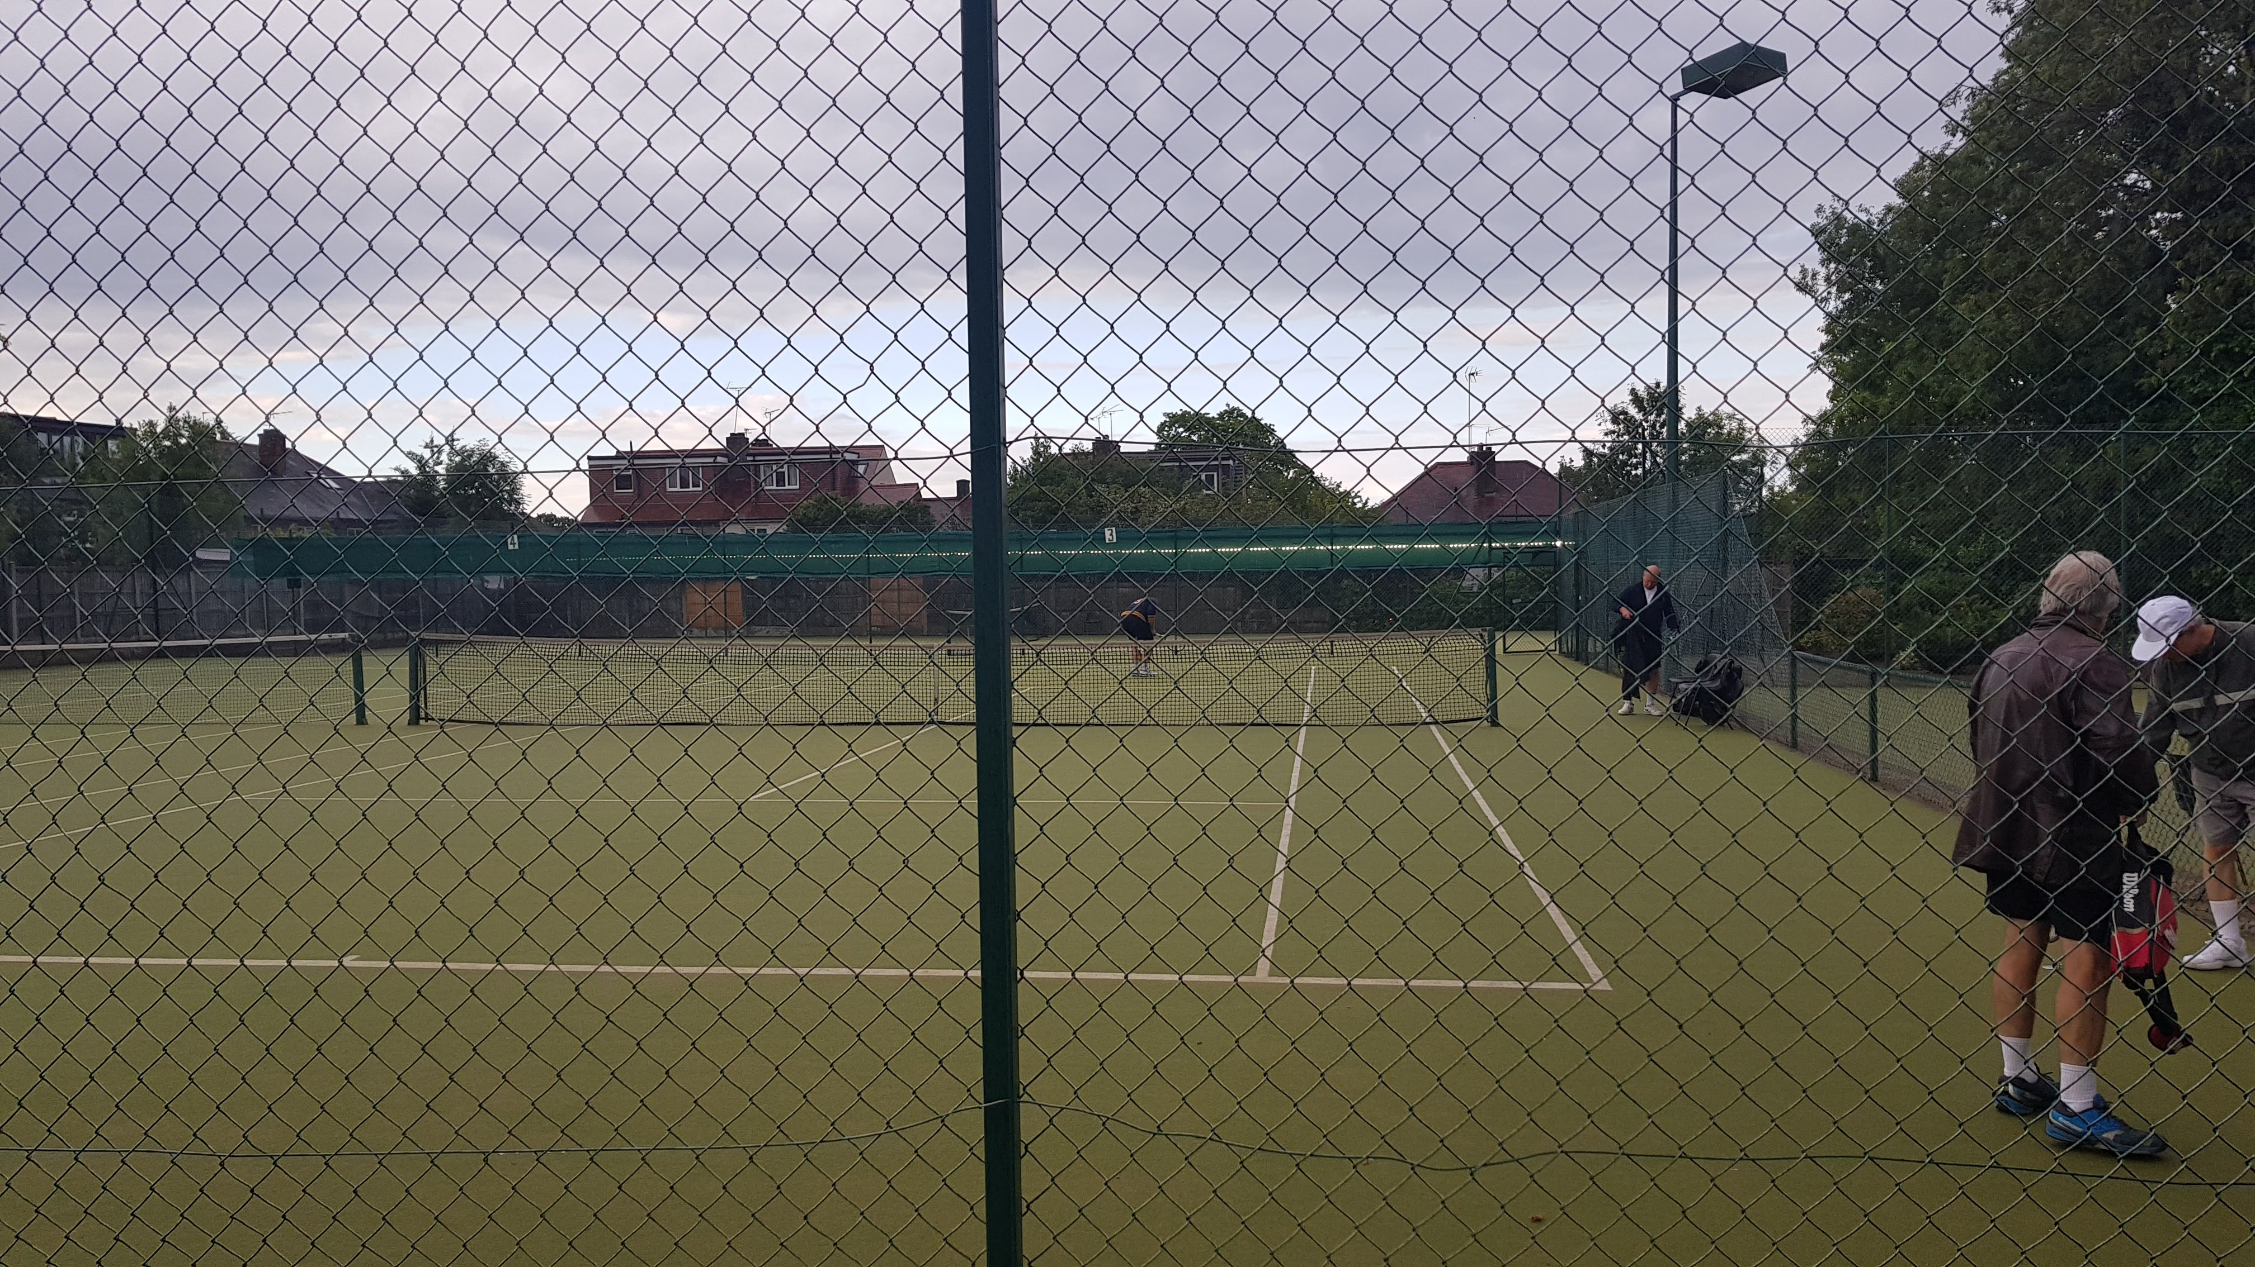

Slide 10
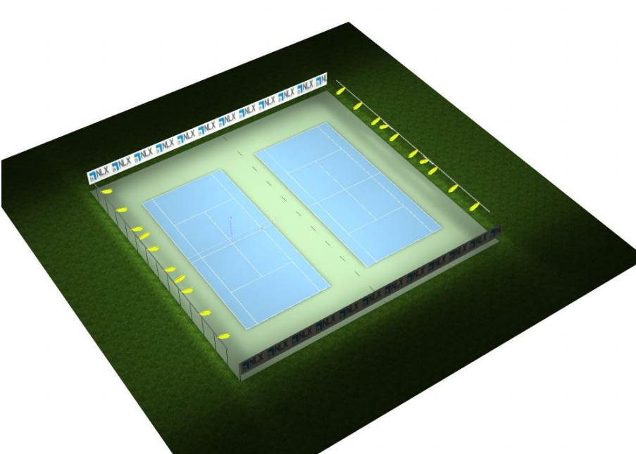

Slide 11
Final Bid

Slide 12
Conclusions
Both Firm A and Firm C are well respected organisations and references for both resulted in a conclusion either would be satisfactory partners to proceed with. Both were excellent to work with.
Firm C was able to secure greater discounts for our project from their suppliers. The differential in bids is significant.
The surface, lighting and fencing are all fit and proper solutions for our needs.
Planning permission will be needed for the entire project, not just the lighting. (Clerk has confirmed this)
A divider net will be necessary to ensure two different sports can occur safely concurrently.

Slide 13
Recommendations
Select Firm C and proceed to contractual terms.
Start the planning permission process.
Set aside £80K to cover project costs and legal/planning fees/PIN Gate.
Inlay only Tennis, Football and Netball. Paint on Basketball lines.
Finalise contractual terms with Tennis Club. To assist this, recommend we hold off for one final month on proceeding with Statutory Process.
Finalise playing schedule/prices so villagers can plan their activities.
Continue reach out wrt to all sports.
Create a sinking fund to cover maintenance costs and surface renewal in 10-12 years.
Utilise ClubSpark for online booking.
Explore CIA Clubspark Gate – PIN Code access.

Slide 14
Implications
New Community Asset: robust, secure and attractive.
Broad appeal across age groups, genders and sporting affiliation.
Lighting allows enhanced playing times for all sports.
Would attract users from neighbouring villages and foster interest in other (team-based) sports.
Tennis club could continue to enjoy exclusive usage periods.
Ongoing maintenance and repairs costs would be planned for and not be a surprise in ten years time. (no ground-hog day)

Slide 15
Any Questions

Slide 16


Information Sheets

